Slide 1
Permutation Tests for Correlation Matrices
Tyler Stoen

Slide 2
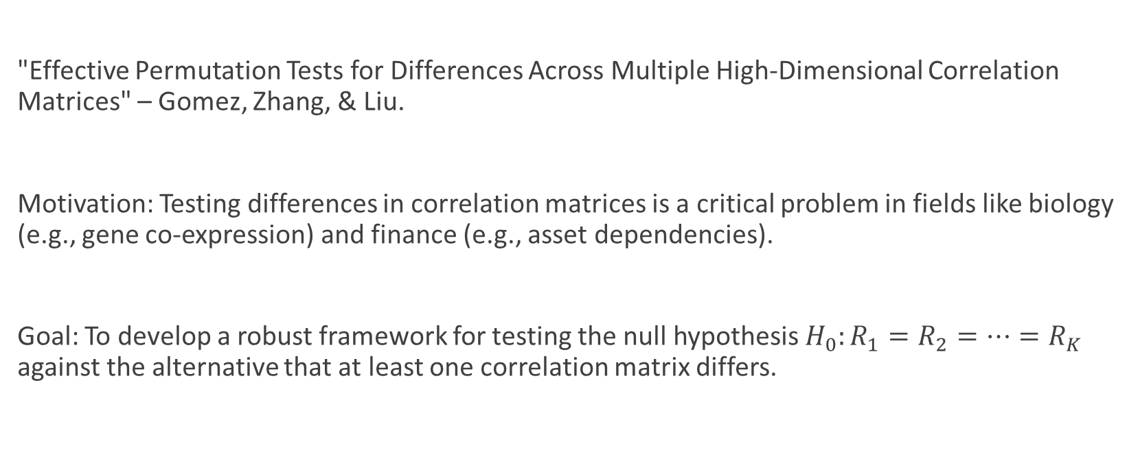
Paper Introduction
"Effective Permutation Tests for Differences Across Multiple High-Dimensional Correlation Matrices" – Gomez, Zhang, & Liu.
Motivation: Testing differences in correlation matrices is a critical problem in fields like biology (e.g., gene co-expression) and finance (e.g., asset dependencies).
Goal: To develop a robust framework for testing the null hypothesis $H_{0}:R_{1}=R_{2}=…=R_{K}$ against the alternative that at least one correlation matrix differs.
Notes:
Walk through what the null hypothesis means with example context.

Slide 3
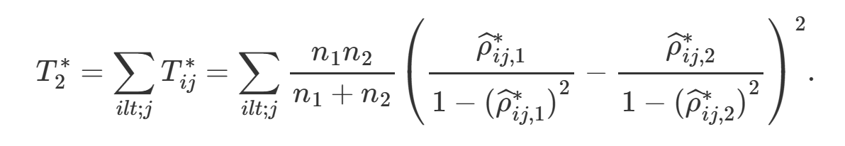
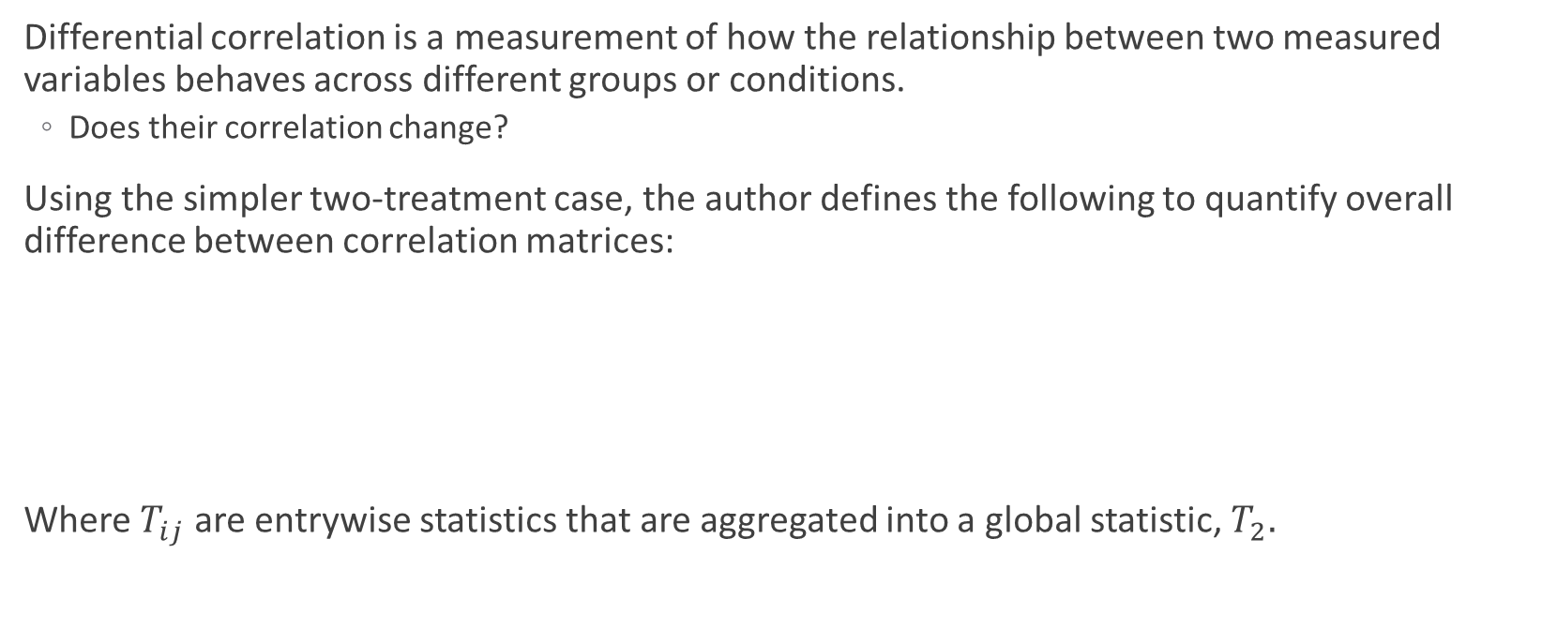
Differential Correlation
Differential correlation is a measurement of how the relationship between two measured variables behaves across different groups or conditions.
Does their correlation change?
Using the simpler two-treatment case, the author defines the following to quantify overall difference between correlation matrices:
Where $T_{ij}$ are entrywise statistics that are aggregated into a global statistic, $T_{2}.$
Notes:
Importantly, they don’t test the entry-wise statistics and there is no mention of any testing of them in the paper, only serves the purpose of generating the overall statistic.

Slide 4
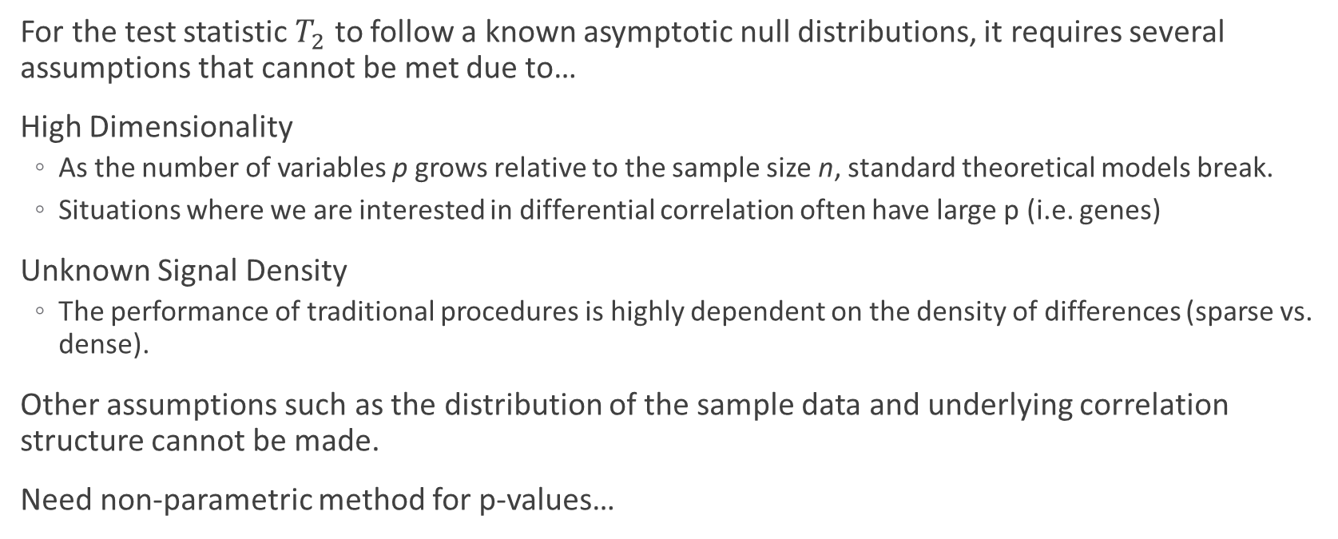
The Problem
For the test statistic $T_{2}$ to follow a known asymptotic null distributions, it requires several assumptions that cannot be met due to…
High Dimensionality
As the number of variables p grows relative to the sample size n, standard theoretical models break.
Situations where we are interested in differential correlation often have large p (i.e. genes)
Unknown Signal Density
The performance of traditional procedures is highly dependent on the density of differences (sparse vs. dense).
Other assumptions such as the distribution of the sample data and underlying correlation structure cannot be made.
Need non-parametric method for p-values…

Slide 5
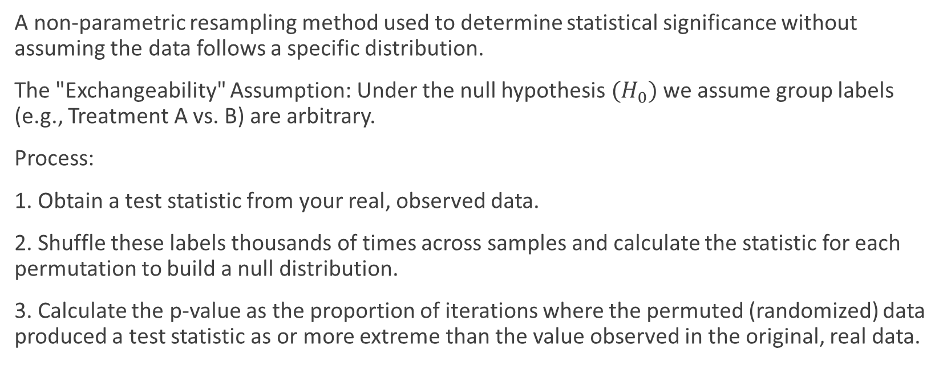
Permutation Testing
A non-parametric resampling method used to determine statistical significance without assuming the data follows a specific distribution.
The "Exchangeability" Assumption: Under the null hypothesis ${(H}_{0})$ we assume group labels (e.g., Treatment A vs. B) are arbitrary.
Process:
1. Obtain a test statistic from your real, observed data.
2. Shuffle these labels thousands of times across samples and calculate the statistic for each permutation to build a null distribution.
3. Calculate the p-value as the proportion of iterations where the permuted (randomized) data produced a test statistic as or more extreme than the value observed in the original, real data.
Notes:
Example usage in context of our problem.
Explain that it is applicable for almost any situation, but is highly computationally expensive, thus its low utilization.

Slide 6
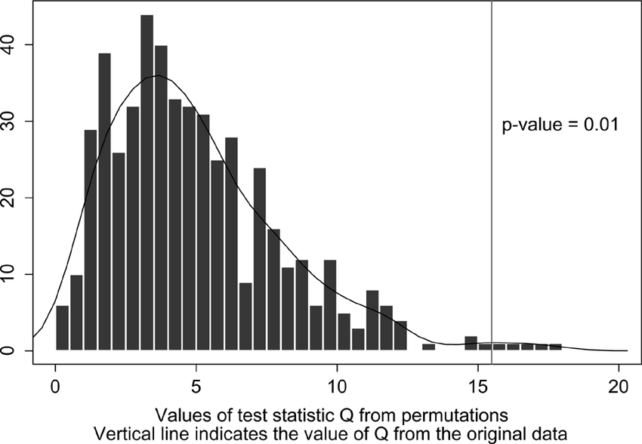
Example Permuted Distribution

Slide 7
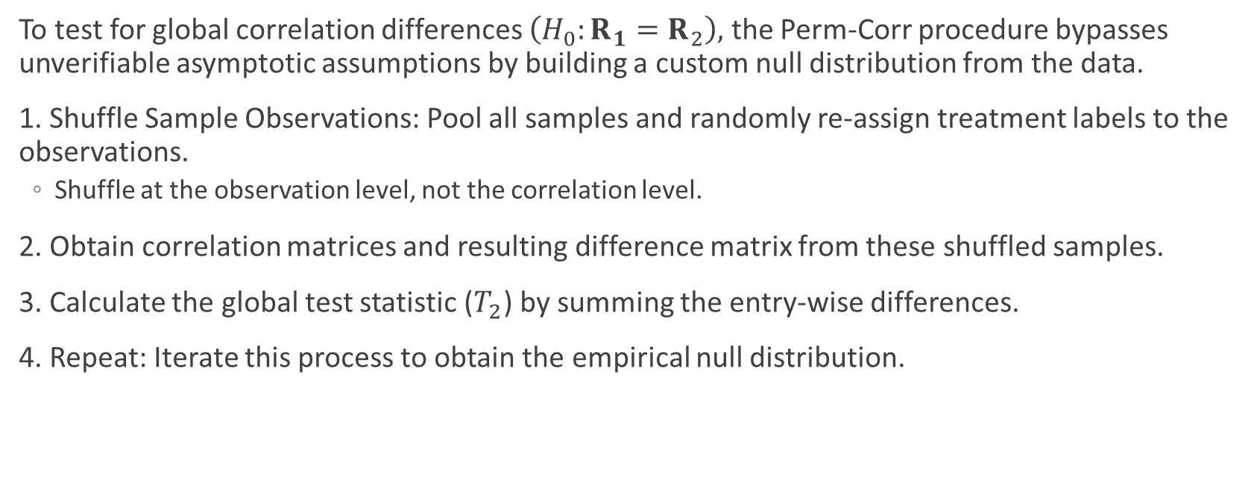
Perm-Corr
To test for global correlation differences $\left(H_{0}:R_{1}=R_{2}\right),$ the Perm-Corr procedure bypasses unverifiable asymptotic assumptions by building a custom null distribution from the data.
1. Shuffle Sample Observations: Pool all samples and randomly re-assign treatment labels to the observations.
Shuffle at the observation level, not the correlation level.
2. Obtain correlation matrices and resulting difference matrix from these shuffled samples.
3. Calculate the global test statistic ($T_{2}$) by summing the entry-wise differences.
4. Repeat: Iterate this process to obtain the empirical null distribution.
Notes:
2 “levels” involved here, the observation level and the correlation level. Shuffling the correlations doesn’t change the

Slide 8
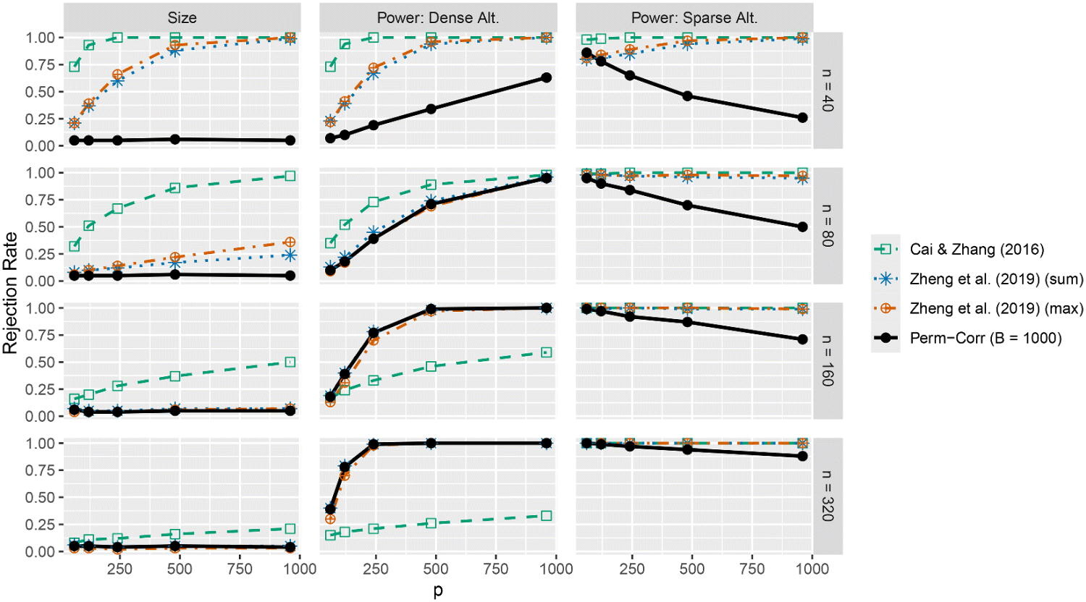
Method Implications for Simulated Data
Rejection Rates even for high dimensionality at advertised alpha
Misleading power guarantees for other methods, i.e. poorly controlled rejection rates

Slide 9
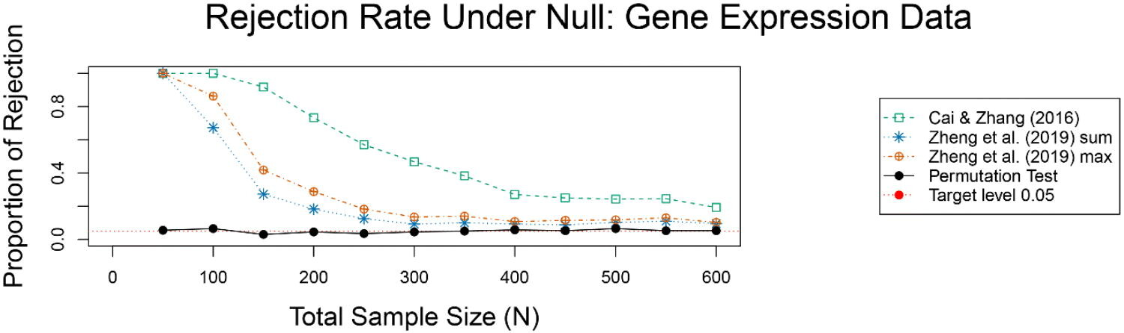
Data Application – Gene Expression
Notes:
Under the null, we expect 5% rejection rate. Permutation test hovers at around 0.05 even for small sample sizes. Even at the largest sample size, the Cai & Zhang rejection rate still is at 19%

Slide 10
My Thesis
Goal: Develop a framework that identifies groups of variables that experience shared changes in correlation across multiple groups through the DCM procedure.
DCM Procedure:
1. Determine differential correlations
2. Identify candidate sets of variables (cliques)
Start with an initial set A0 (possibly empty).
Iteratively add/remove variables based on whether they have a significant positive average differential correlation with the current set.
Stop when the set stabilizes (no variables change).
3. Assess statistical significance
Appropriate testing method
Adjust for multiple testing (e.g., Benjamini-Hochberg Procedure).
4. Output significant variable sets
These sets are the ones you’d investigate further (e.g., genes that change co-expression between healthy and disease states).”

Slide 11
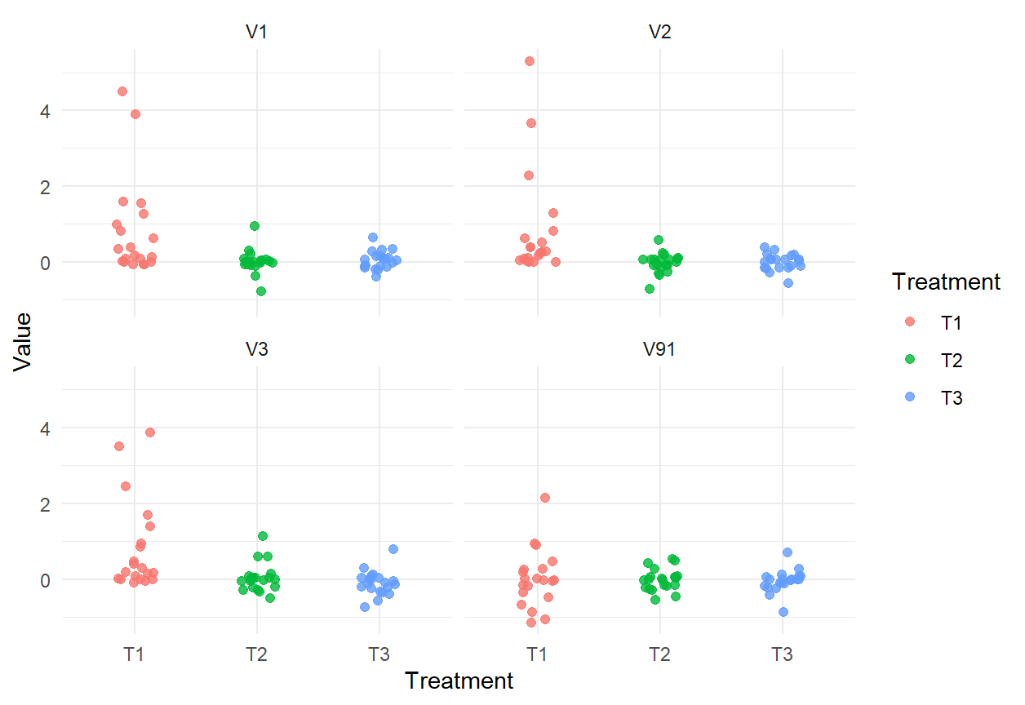
Thesis Connection
Similarities:
Still have a lack of asymptotic null distribution to derive p-values, so we require non-parametric methods.
My method uses permutation testing as one possible option for p-value computation.
Data applications are of similar structure (low sample size/high dimensionality)
Notes:
Bullet 1 is a consequence of 2.

Slide 12
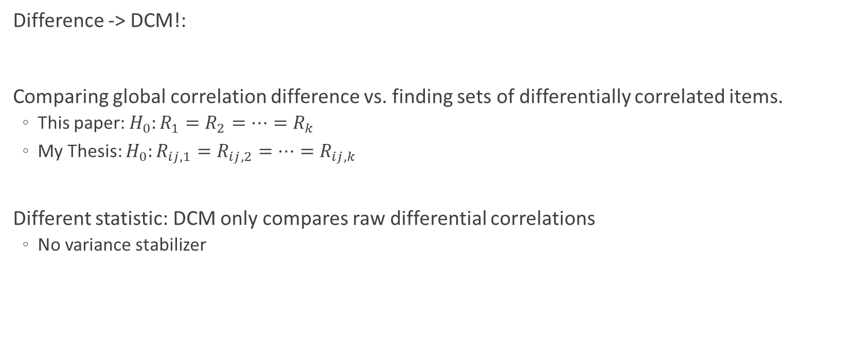
Thesis Connection
Difference -> DCM!:
Comparing global correlation difference vs. finding sets of differentially correlated items.
This paper: $H_{0}:R_{1}=R_{2}=…=R_{k}$
My Thesis: $H_{0}:R_{ij,1}=R_{ij,2}=…=R_{ij,k}$
Different statistic: DCM only compares raw differential correlations
No variance stabilizer
Notes:
The test statistic I

Slide 13
References
Gómez, J. Á. S., Zhang, E., & Liu, Y. (2025). Effective Permutation Tests for Differences Across Multiple High-Dimensional Correlation Matrices. Journal of Computational and Graphical Statistics, 1-10.
Bodwin, K., Zhang, K., & Nobel, A. (2018). A testing based approach to the discovery of differentially correlated variable sets. The annals of applied statistics, 12(2), 1180.

Slide 14
Thank you!

